Slide 1
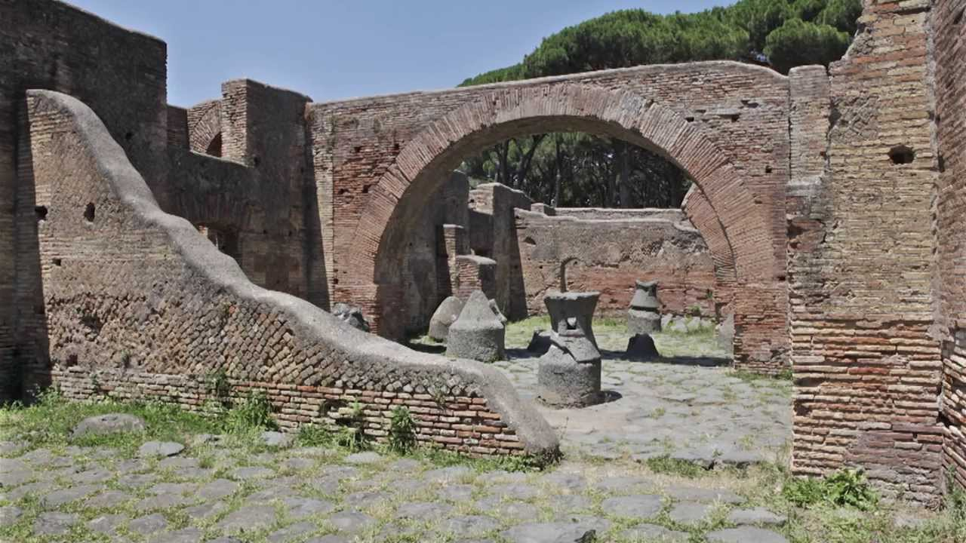
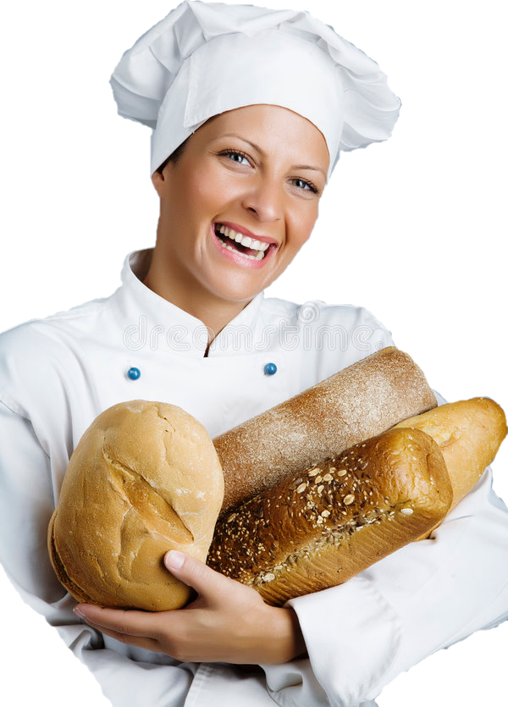

The House of the Miller AKA The House of the Millstones
Presentation by Piper Boeth

Slide 2
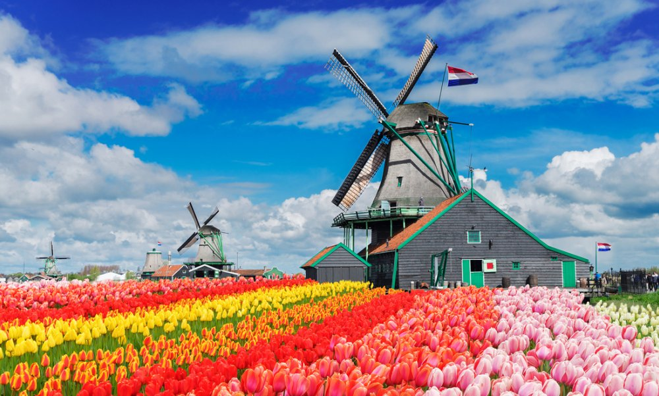
First Things First:
Woah that’s cool!
What is a Mill?
Used to process grain and turn it into flour for baking.
Buildings often functioned as both mills and bakeries.

Slide 3
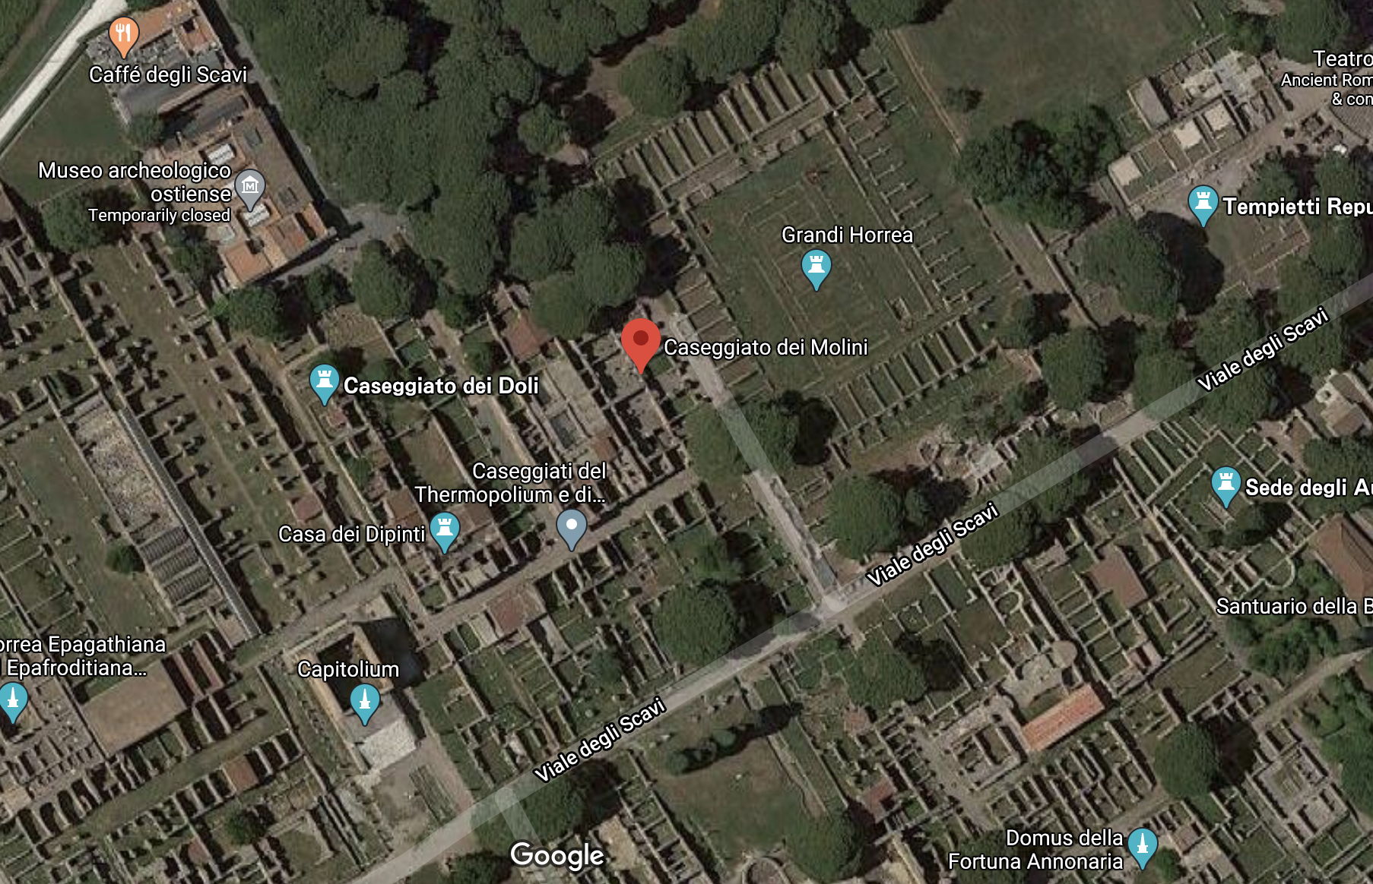
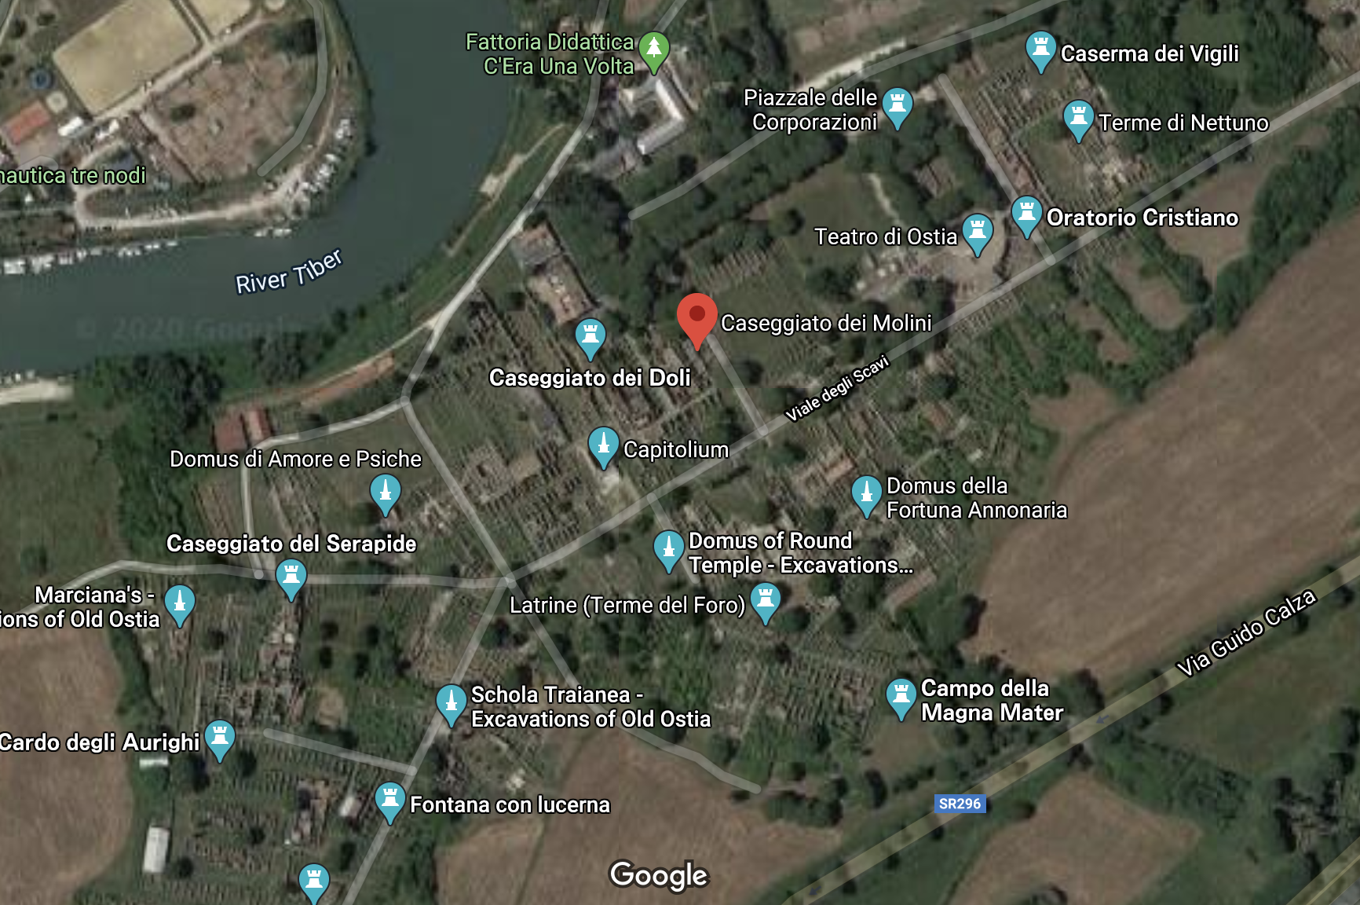
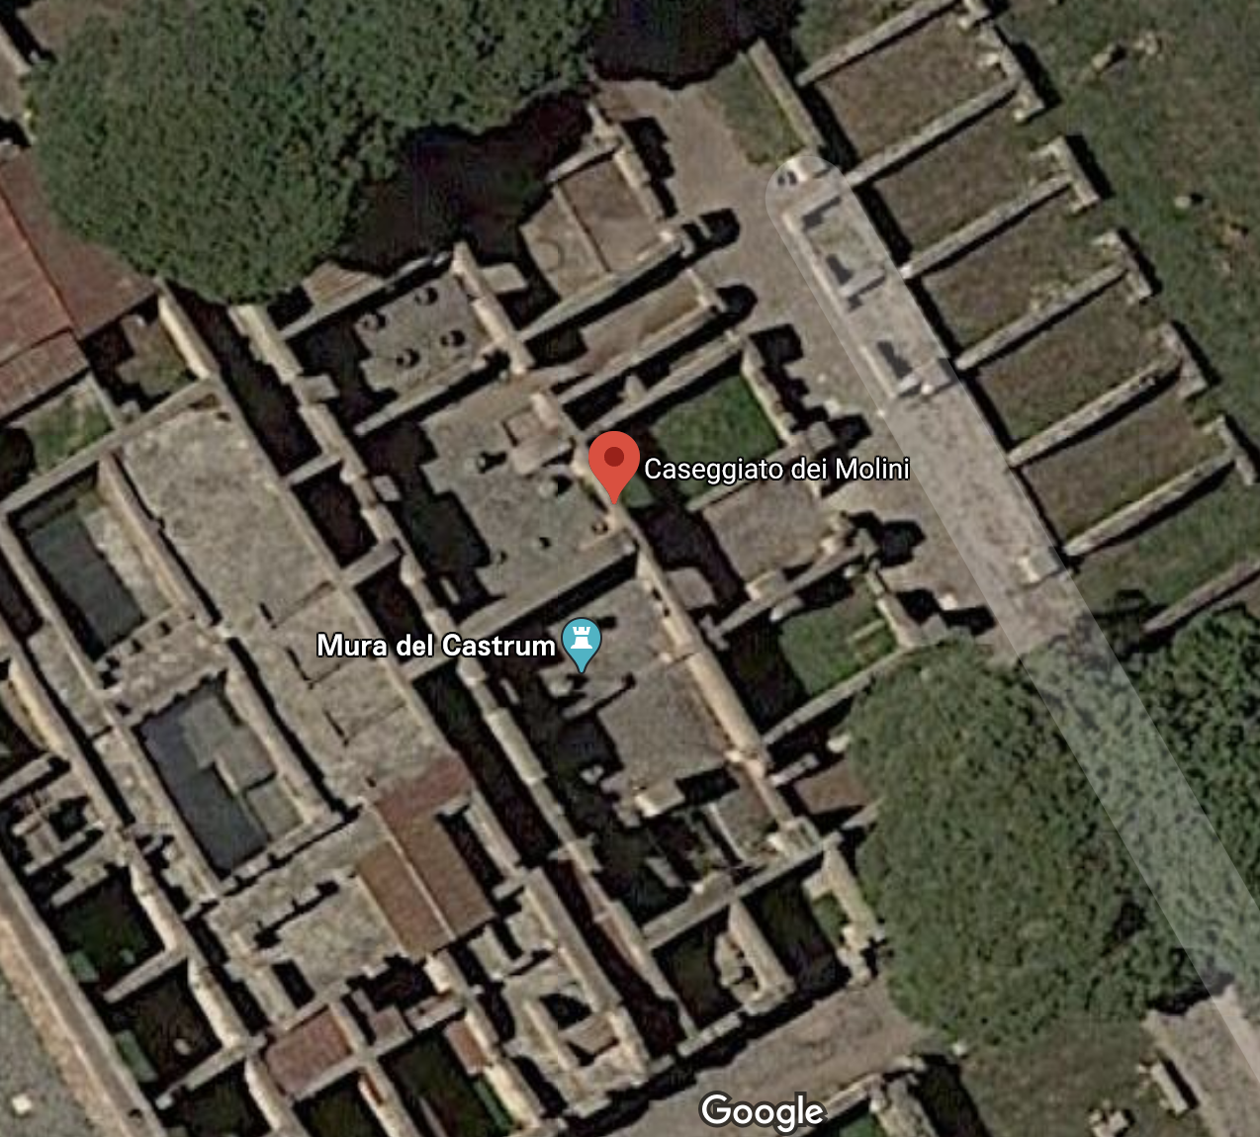
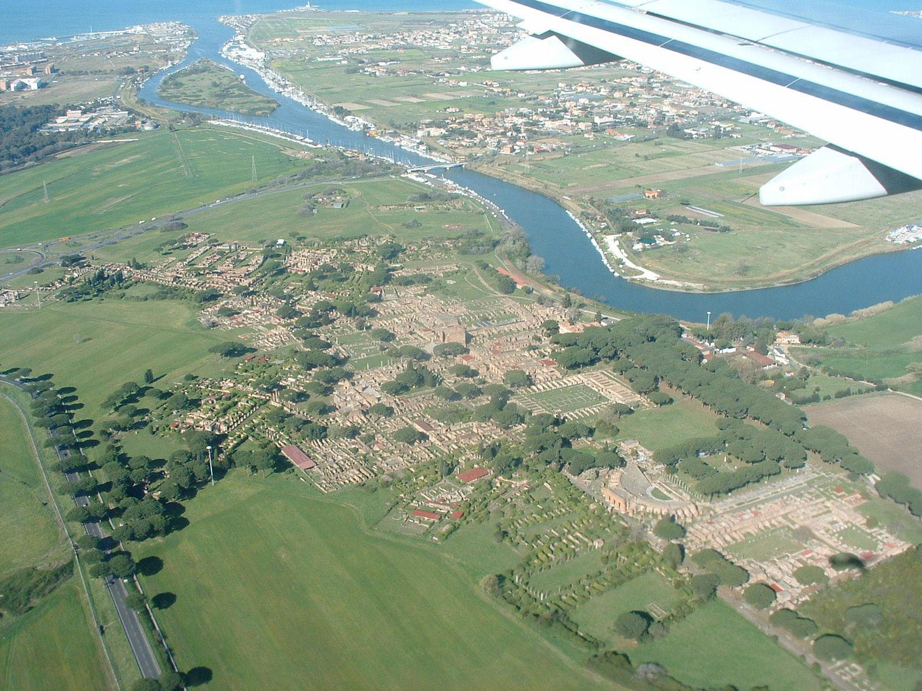
Where is it?

Slide 4
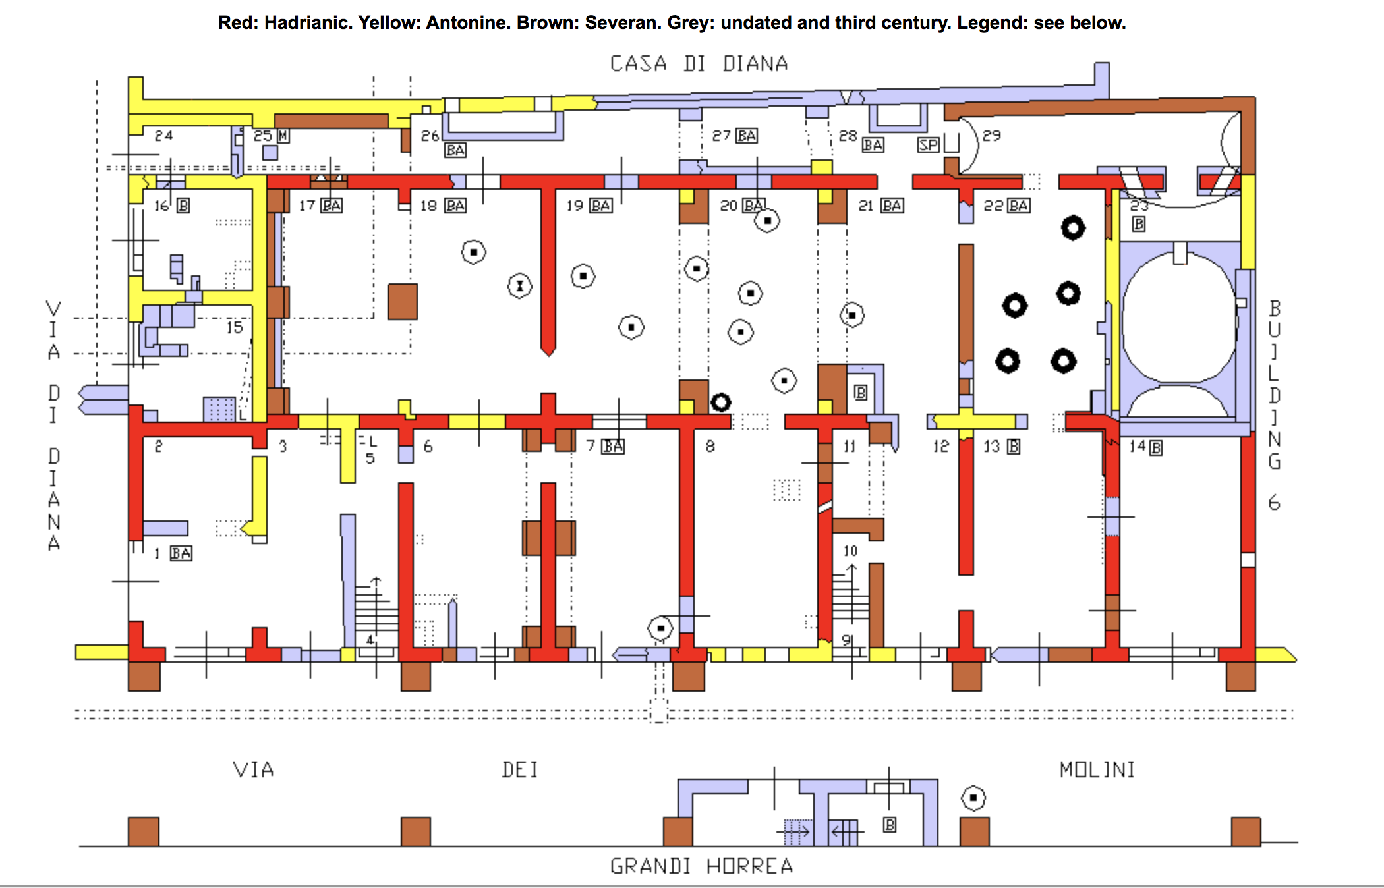
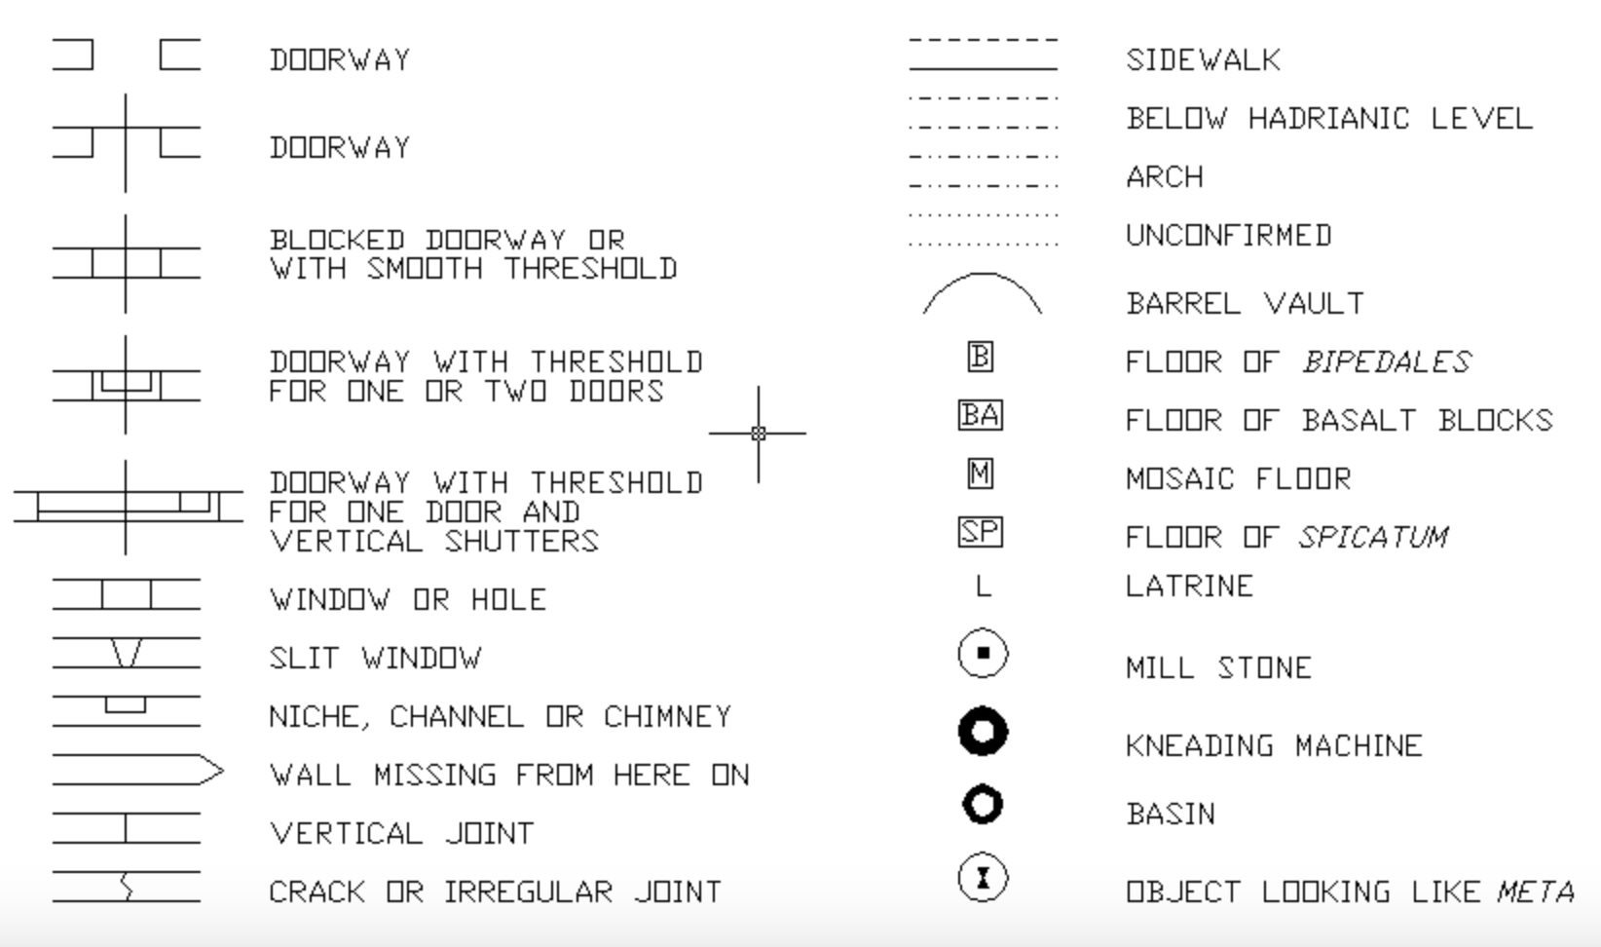
The Basics:
Built in the early 2nd Century CE.
Converted into a mill/bakery during Severan period expansion.
Destroyed by a firequake in the late 3rd Century CE.
Excavated multiple times, first in 1870 and again from 1914-1916.

Slide 5
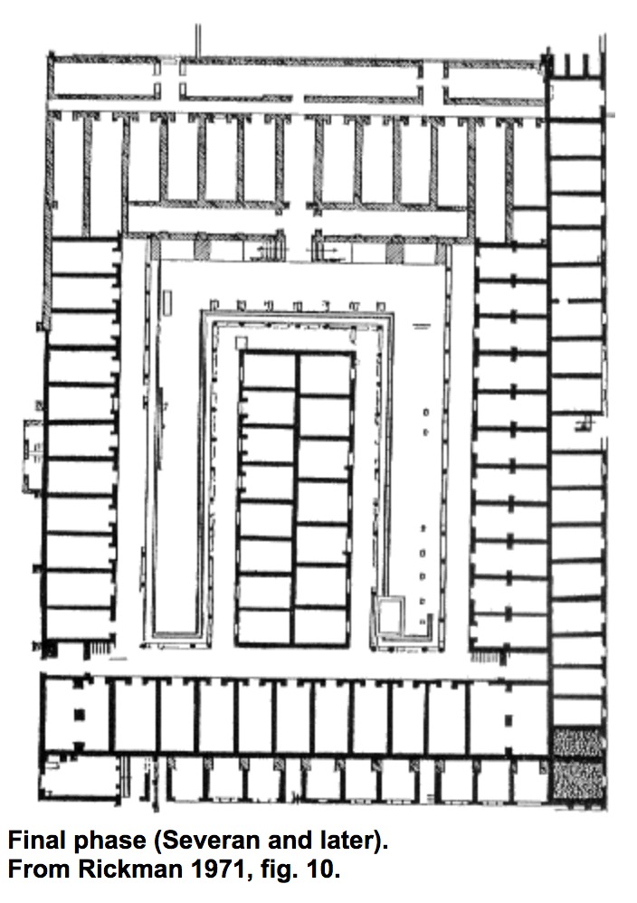
What Have We Found?
Large hall with millstones (room 19-21)
Room 22 showing five kneading machines (shown from the west)

Slide 6
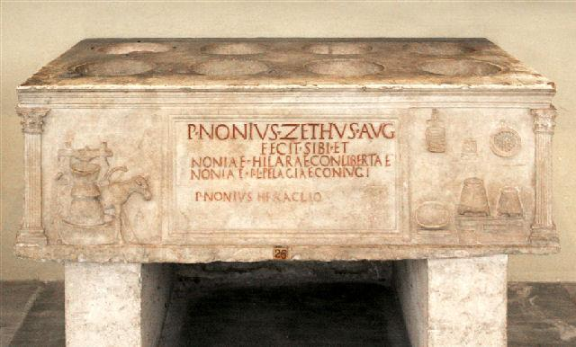
What Have We Found?
Yep, me again!
Translation:
It was made by P. Nonius Zethus, Aug(ustalis), for himself, the fellow freedwoman Nonia Hilara and his wife Nonia Pelagia.

Slide 7
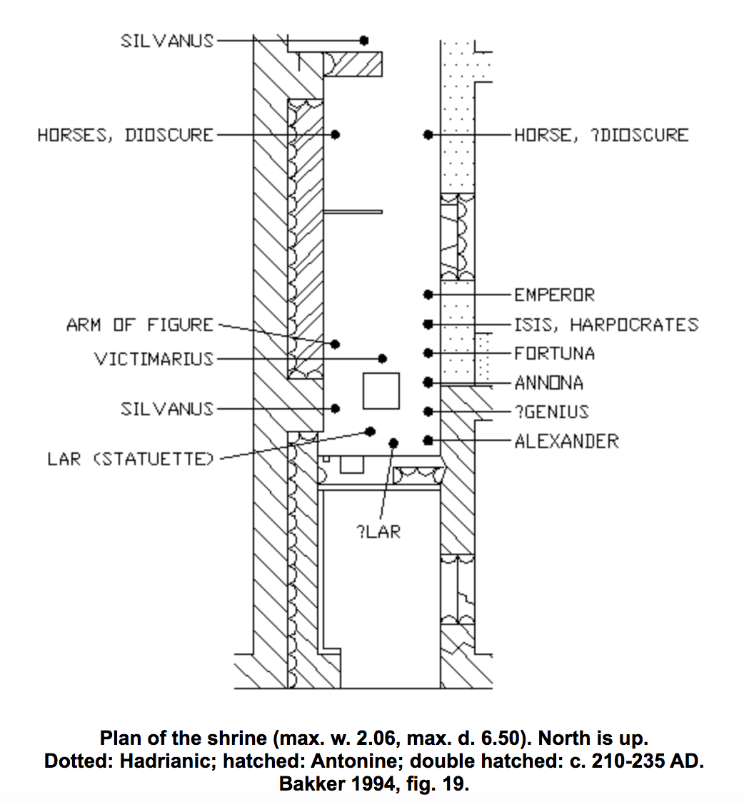
Additional Elements:
Shrine of Silvanus:
50 Bronze and 50 Silver statuettes found in 1870.
Silvanus- God of the Countryside, worshipped extensively by slaves and freed(wo)men.
Emperor (possibly Augustus) – symbolic of source of fiscal grain.
Isis and Harpocrates – Egyptian deities representative of plenty and fertility, as well as grain coming from Egypt.
Fortuna, Castor & Pollux- safe shipments.
Anonna- personification of food supply, esp. grain.
Wealthy Apartments: “parts of bronze revetment of furniture were found (sometimes with silver inlay), elaborate candelabra, fragments of marble and terracotta friezes with amorino's, parts of black-and-white mosaic floors with geometrical patterns and floral motifs, fragments of painted ceilings, parts of opus sectile, and tesserae of glass-paste” Caseggiato dei Molini, Ostia Antica website

Slide 8
So What?
More insights into successful freedmen.
Insights into infrastructure necessary to implement imperial policies.
Evidence of large-scale industrialization of certain functions.

Slide 9
Additional Reading:
Meiggs, Russell. Roman Ostia. Oxford [Eng.]: Clarendon Press, 1973. https://hdl-handle-net.libproxy.smith.edu/2027/heb.01453. EPUB.
The Mill-Bakeries of Ostia Antica, https://www.ostia-antica.org/dict/topics/bakeries/bakart.htm
Caseggiato dei Molini, http://www.ostia-antica.org/regio1/3/3-1.htm
Sacello del Silvano, http://www.ostia-antica.org/regio1/3/3-2.htm

